Slide 1

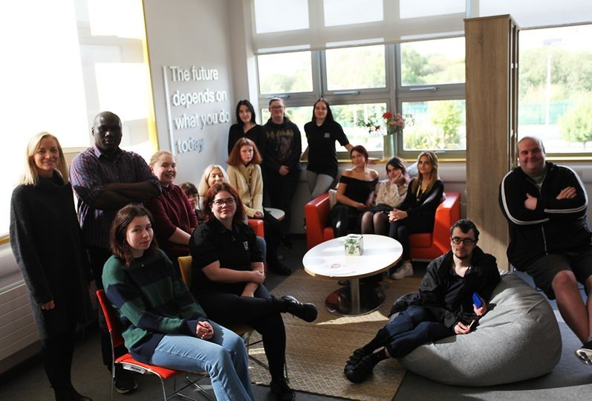
Welcome to Monaghan Institute Student Union (MISU) Clubs and Societies
Making Life better for Students
Let YOUR VOICE be HEARD
MISU Coordinator:
Dr Sinead Nimmervoll

Slide 2
What is in it for YOU and for OTHERS
College Management
Tutors
Our Local & National Community
Other Learners
This is YOUR WAY of communicating and getting YOUR voice to
The Students’ Union is involved in promoting and improving the college experience and quality of life of each learner attending Monaghan Institute.

Slide 3


Why should I become a MISU class representative? What is in it for me?
Opportunity to network - meet new people, share ideas
Have Fun and Laughter as a team together
Sense of responsibility to bring your class views forward
Giving back to our community and having a sense of achievement
Improving your leadership & teamworking skills for your industry sector
Enhance your CV
Have great moments & memories you will never forget!

Slide 4
Roles The MISU team is made up of the following roles and sub-committees
President
Vice-President
Secretary
Vice-Secretary
Treasurer
Vice-Treasurer
Public Relations Officers
Welfare & Safety Officers
Entertainment Officers
Environmental Officers
Team

Slide 5
Election of Board of Management Reps
2 Representatives to be elected
Election & voting will take place in early October
The individuals elected will act as the voice of the Students at Senior Management meetings – to highlight Students Positive experiences and areas for improvement to be considered
The Reps elected must be able to attend TEAMS/inhouse meetings when called on by the College Director. (approx. 1-2 meetings per term)

Slide 6

Anti-bullying policy
MI Follow STRICT anti-bullying policy – zero tolerance policy
Encourage a safe learning environment where everyone present has the right to feel safe
Bullying comes in many different forms and can include:
-LGBT related issues – gender identity and expression policy
Race related
Sectarian
Cultural
Disability

Slide 7

Inclusive and Equal
In college you should be free to:
Be yourself and feel free to express your true identity
Be treated equally and not be discriminated against
Be visible and represented by LGBTQ+ symbols i.e. rainbow flag
Notice Board is beside Library Entrance Doors

Slide 8

Inclusive & Equal Disability – Equal Acts

Slide 9
The MISU team of 2024-2025
See just What OUR Amazing MISU teams have helped to organise for YOU and their communities down through the last few years ….

Slide 10
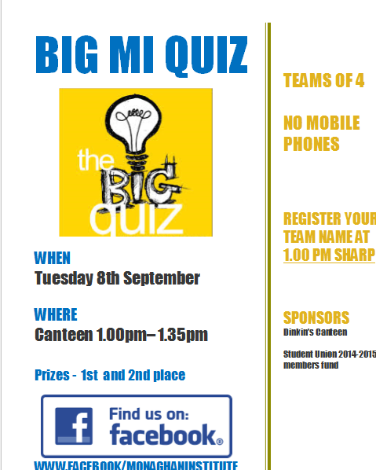

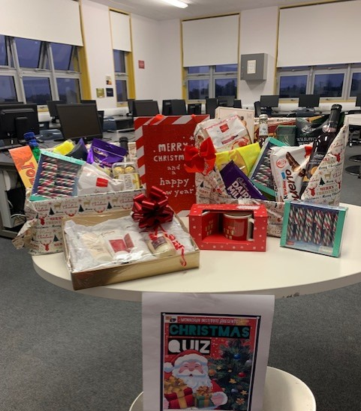
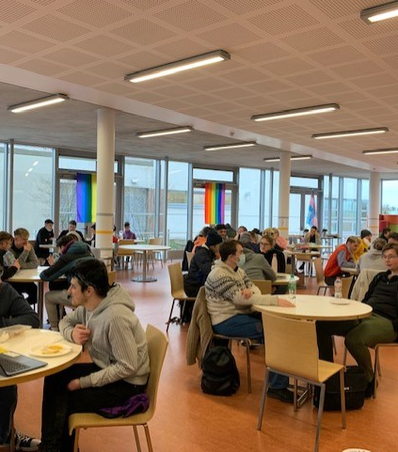
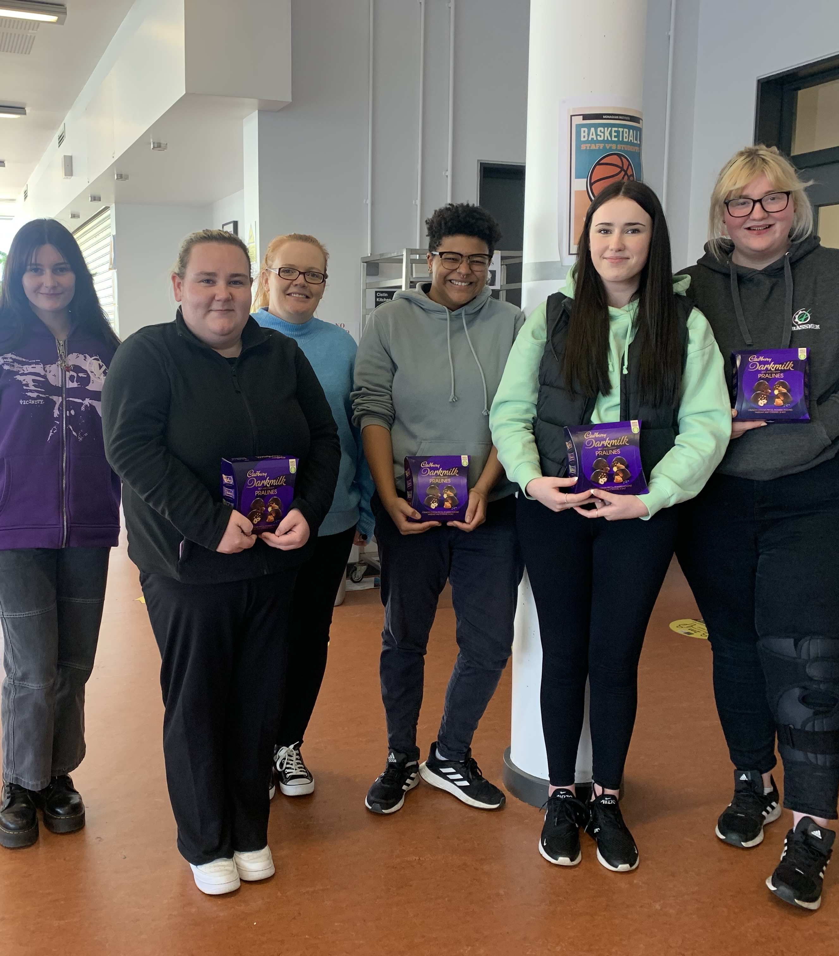
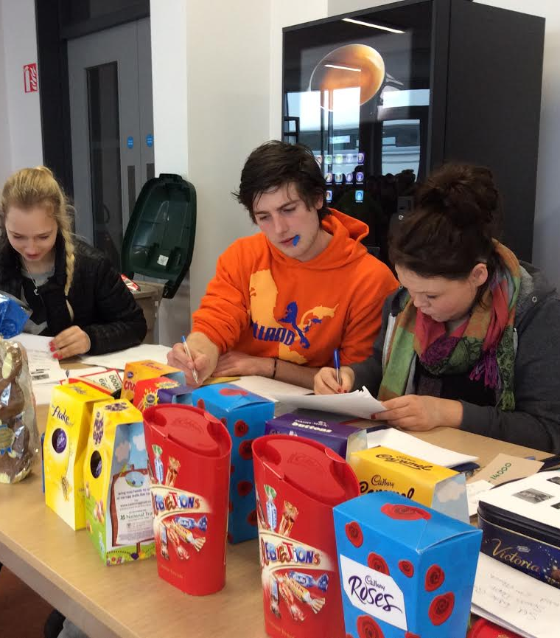
FUN and LAUGHTER over lunchtimes!
With great prizes!

Slide 11
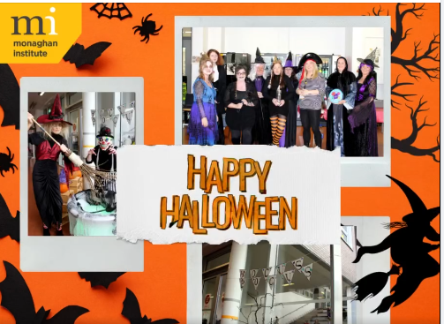
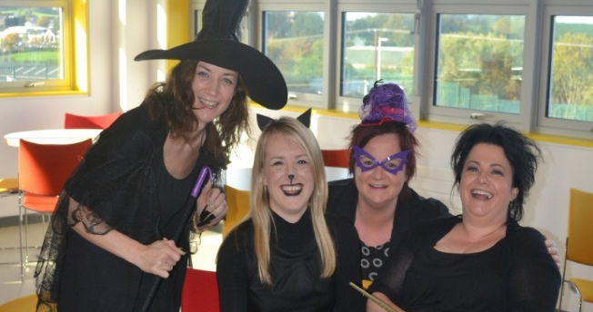
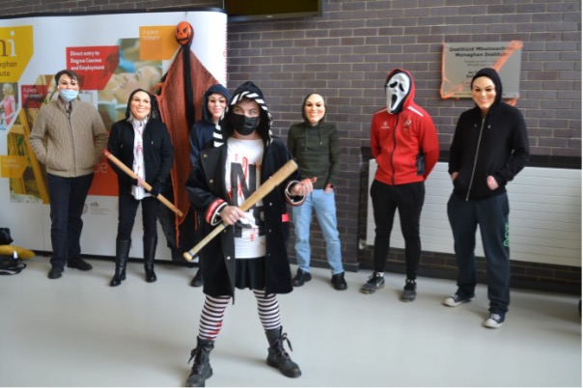
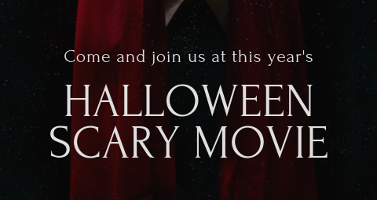
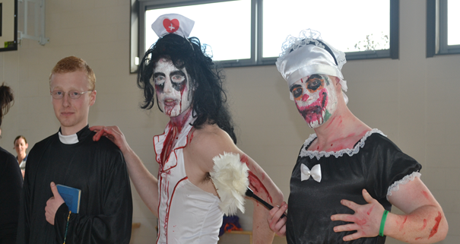
Halloween Events

Slide 12

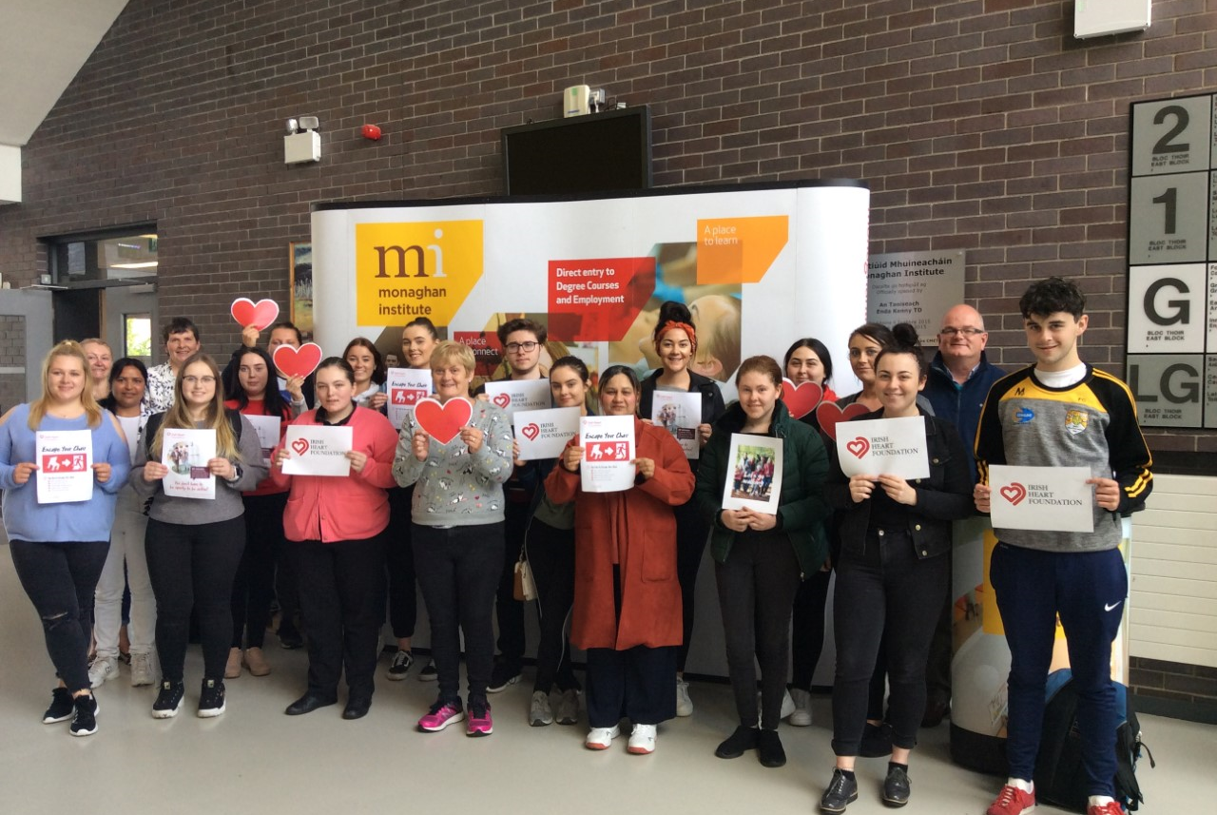

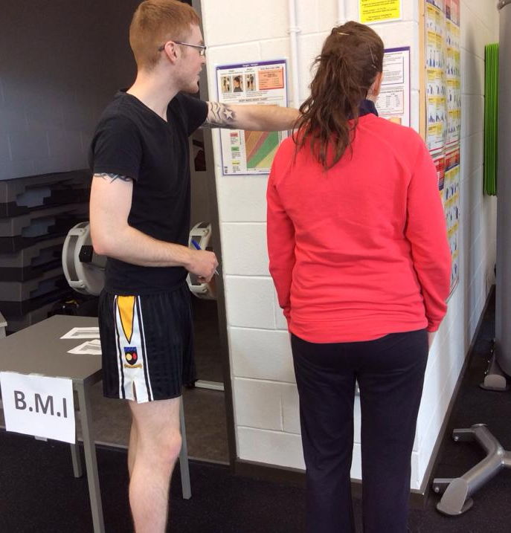

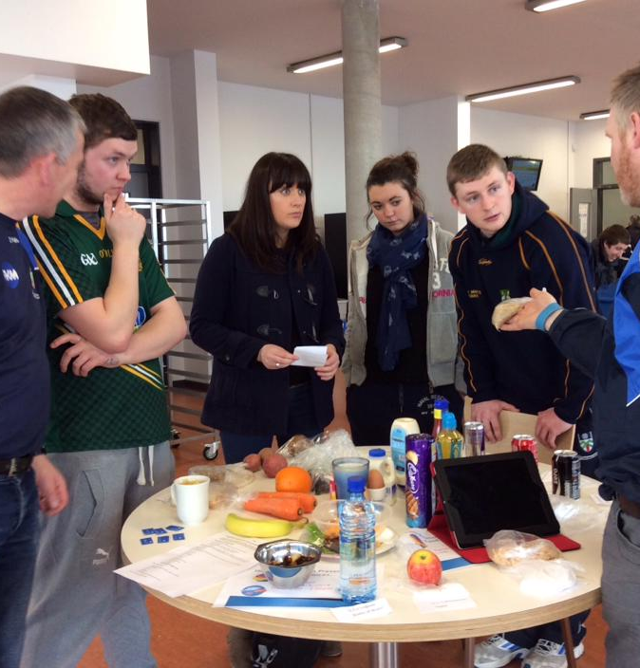
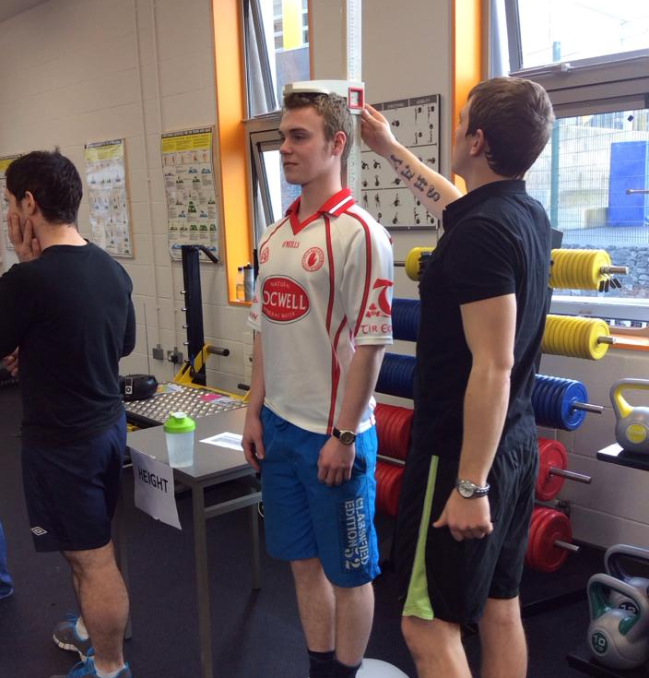
Health Promotion

Slide 13
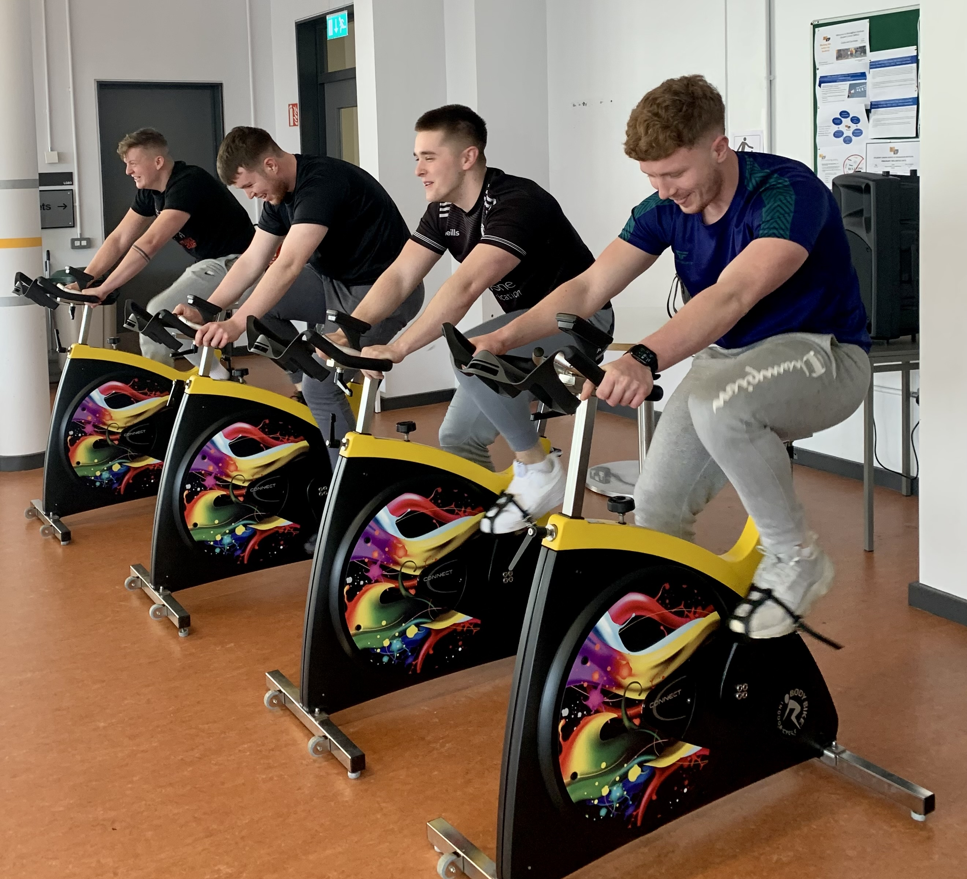
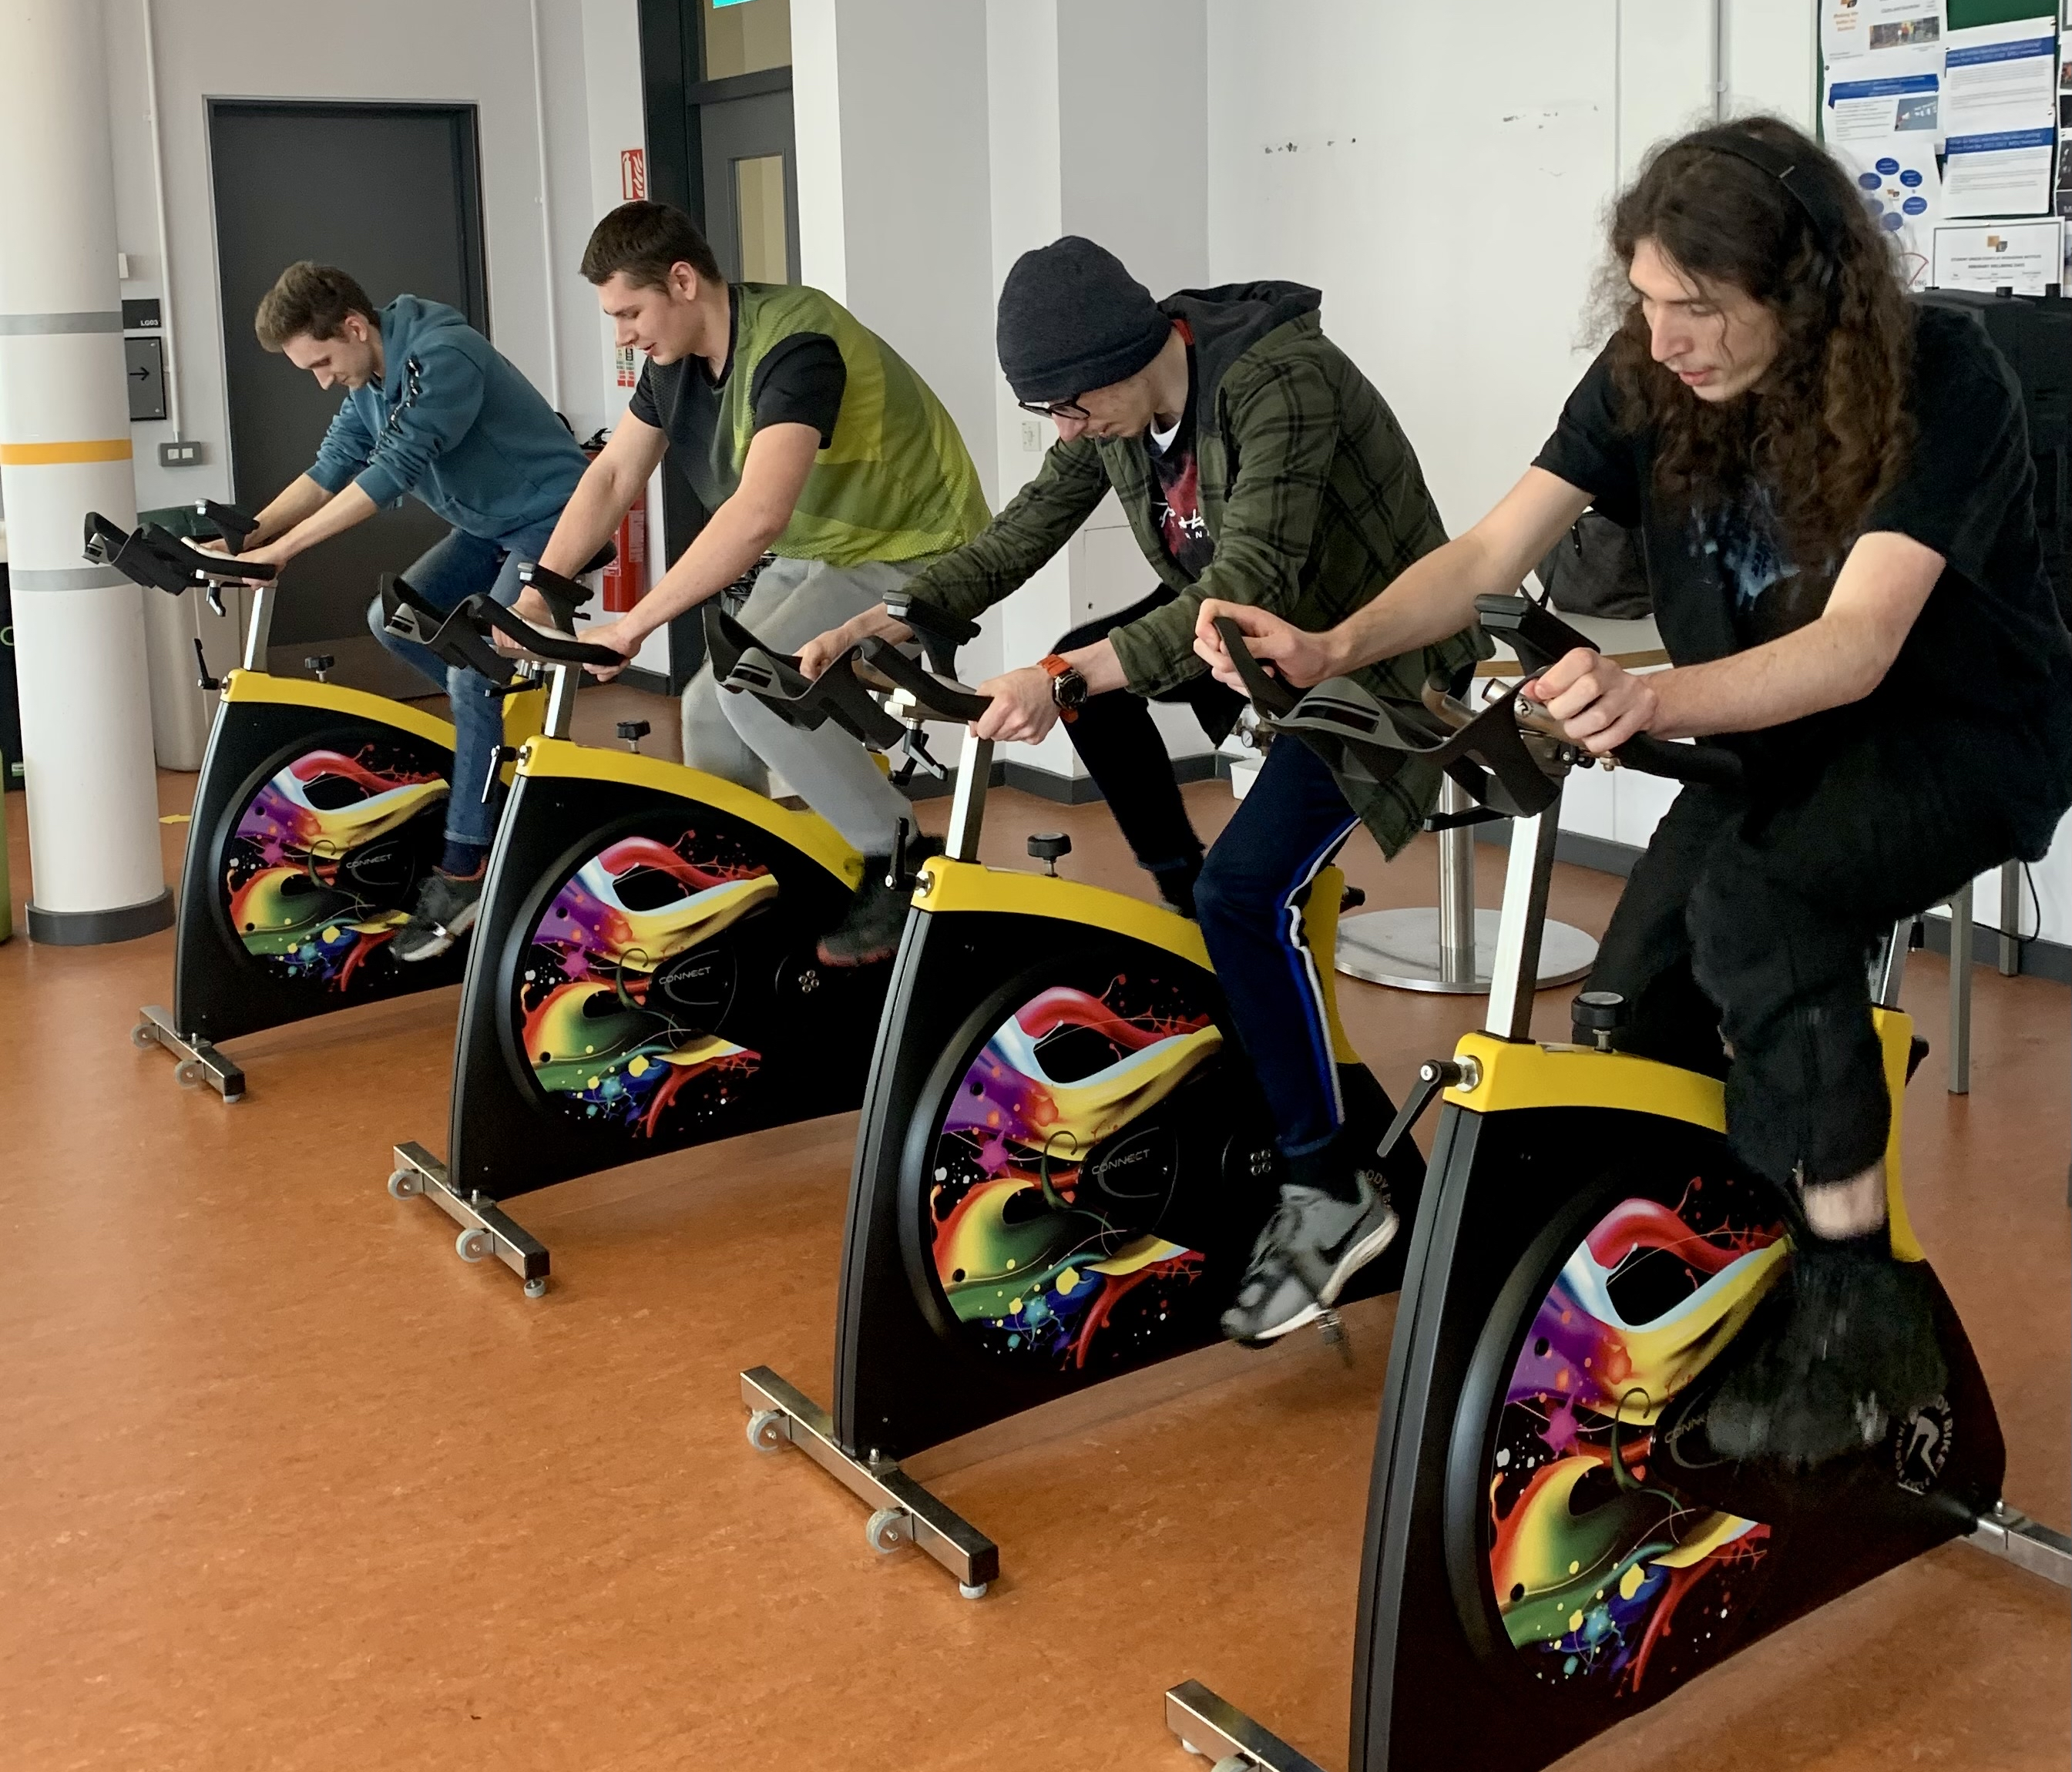
Battle of the classes Are you up for the challenge?
Spin it to Win it!, Lip Sync Battle, Skip to the Beat!

Slide 14
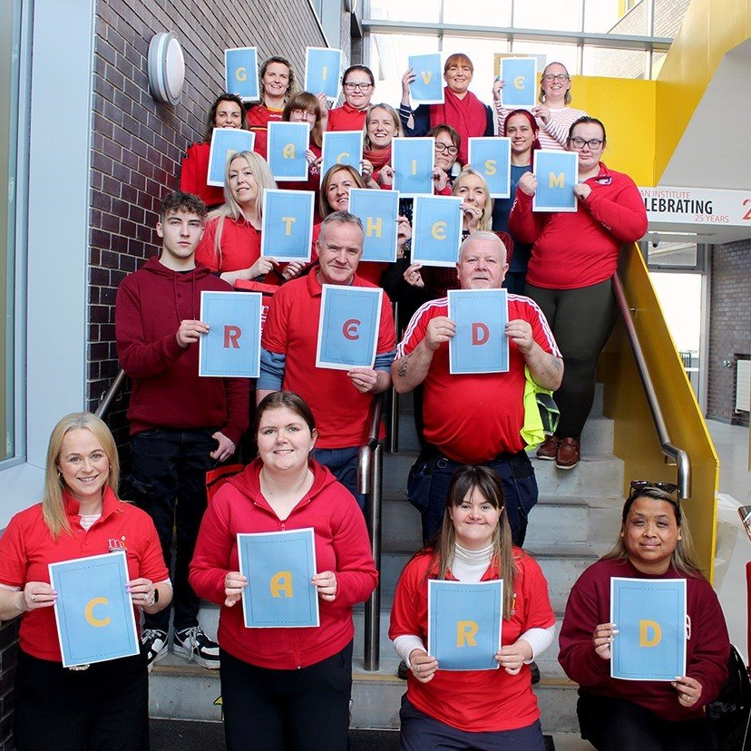
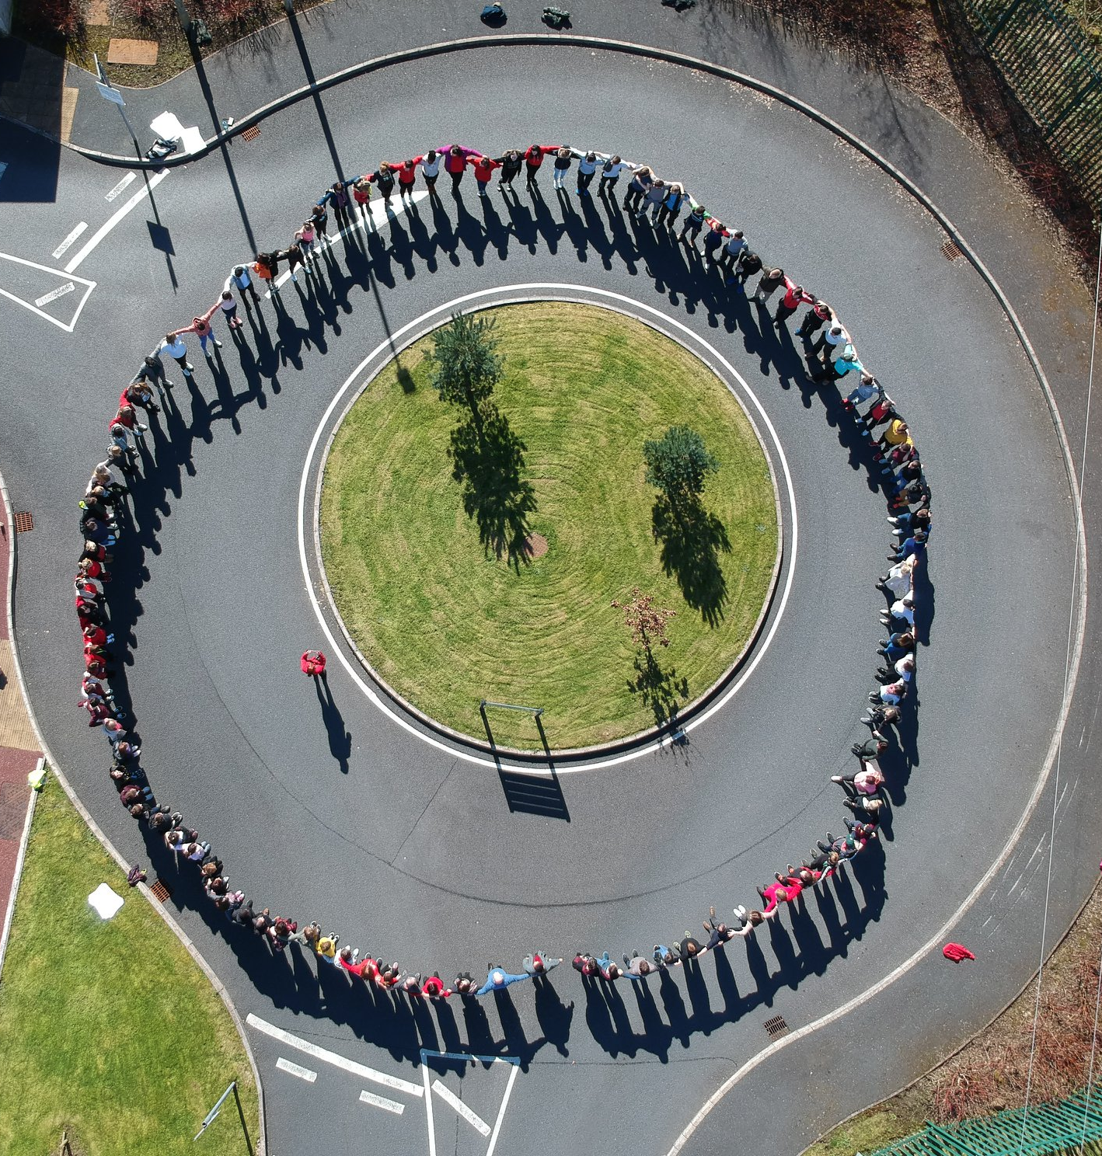

Promoting Awareness Students making a stand against Racism
Click on the video to play
Human Chain against Racism

Slide 15



Activities with Community Organisations
Sports Activities/Events - In conjunction with Monaghan Sports Partnership/Coral Leisure
Innovation Recovery Project – Mental Health Workshop
Dochas - Online events and training programmes

Slide 16
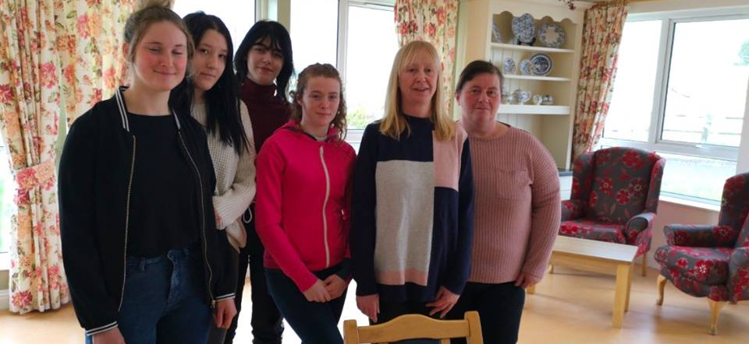
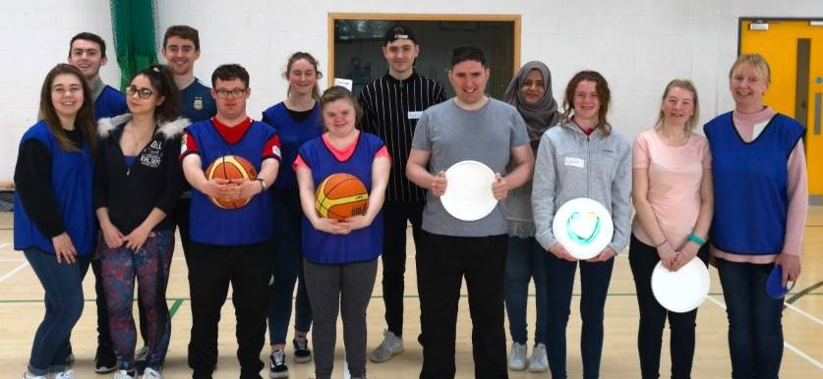
Engaging with Local Community Groups
MI’s Students Union spent a morning with residents at Drumbear Lodge Nursing Home in Monaghan
The Student Union members and the Advanced Level 6 Sports group welcomed students from RehabCare

Slide 17
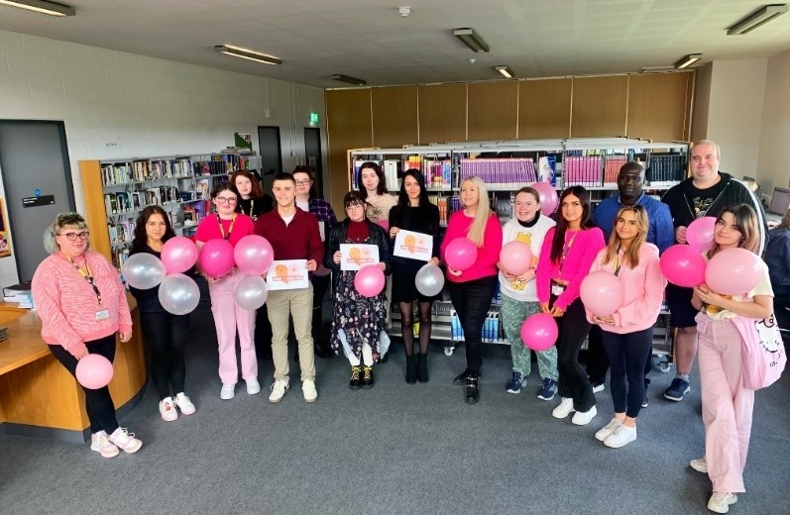
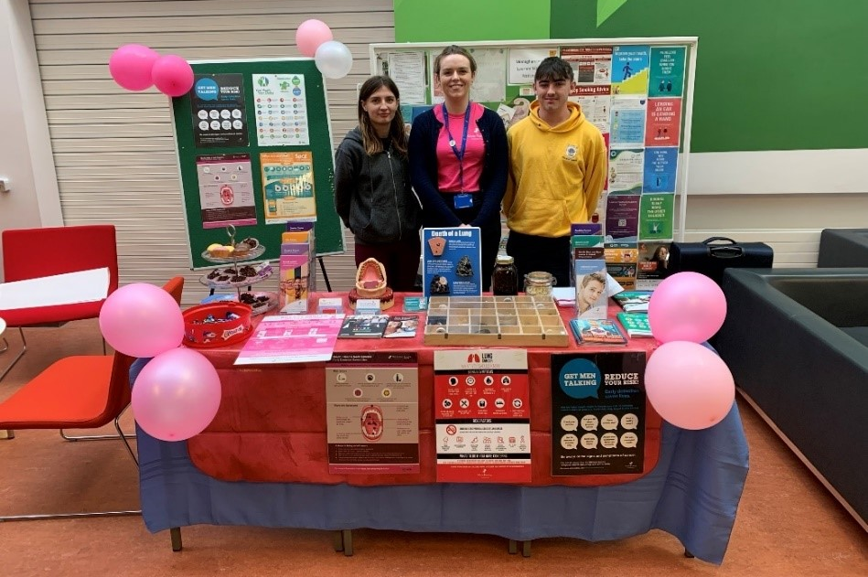

Cancer Awareness – Marie Keating Foundation visits MI

Slide 18

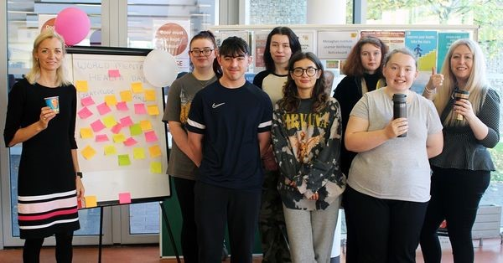
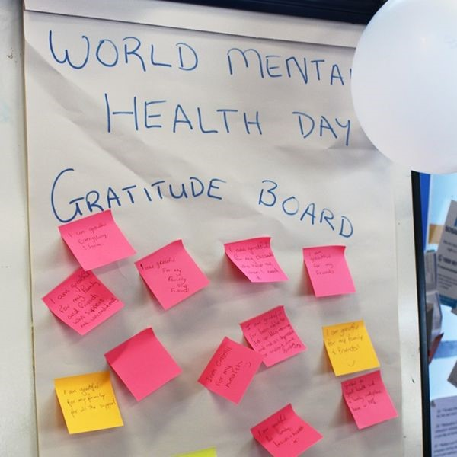
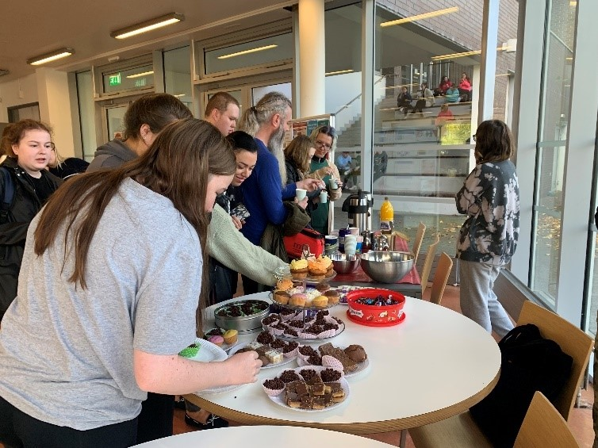

Slide 19
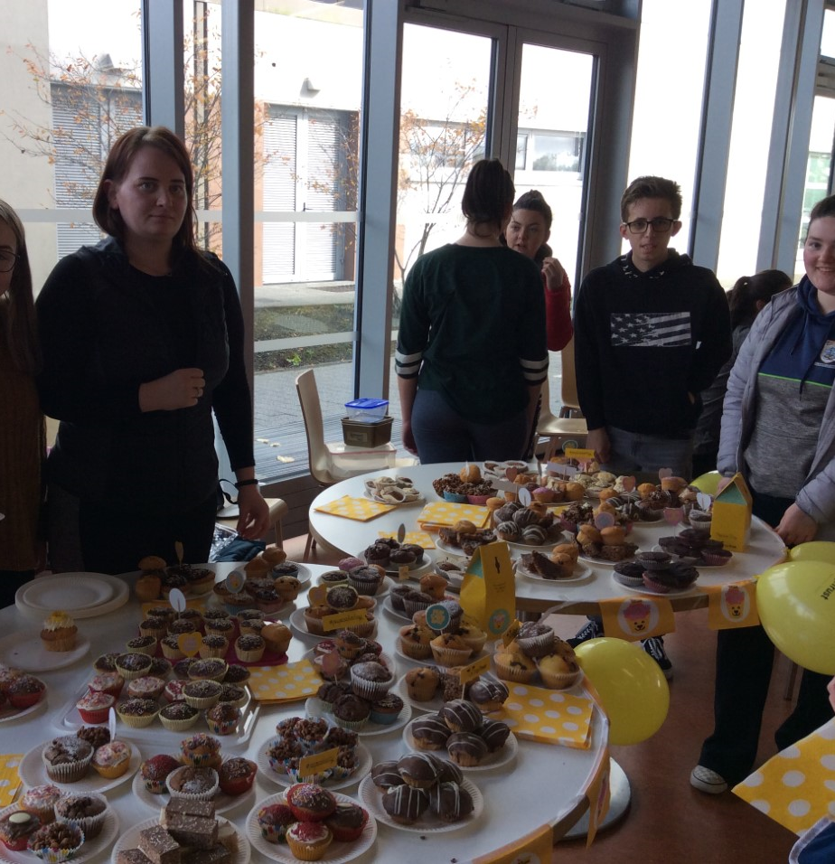
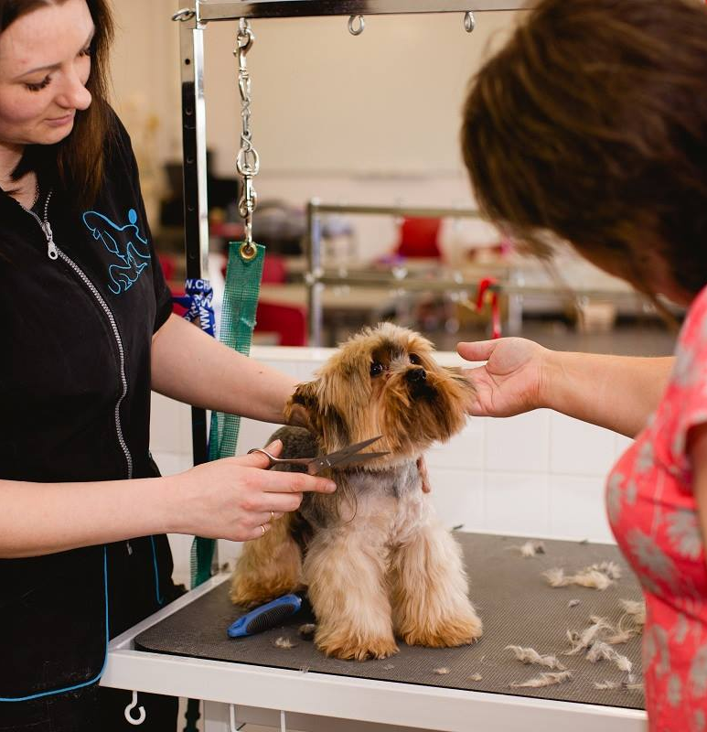
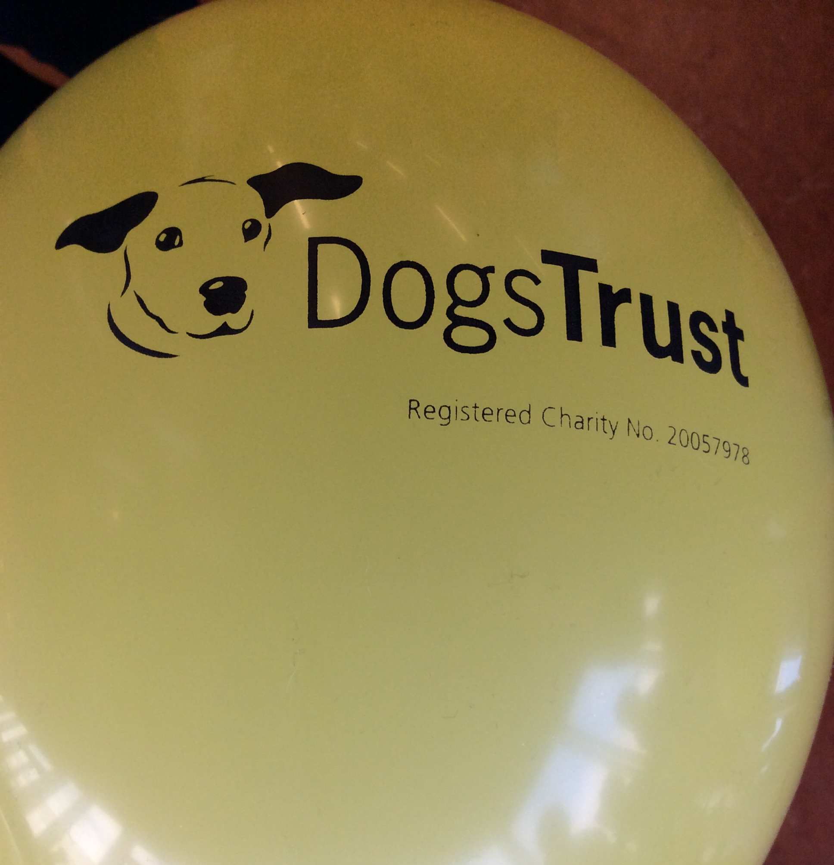
Pup Cakes for The Dogs Trust
Rover Doggy Day Care for Charity

Slide 20

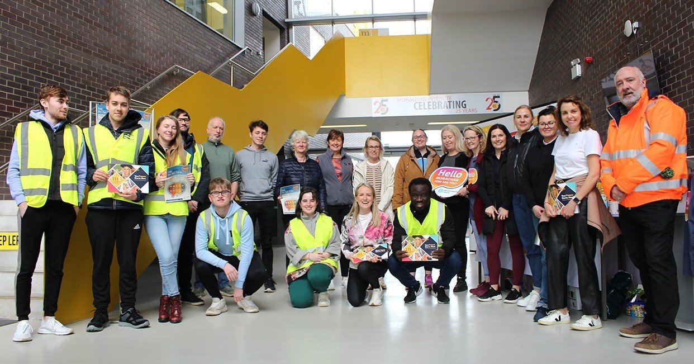
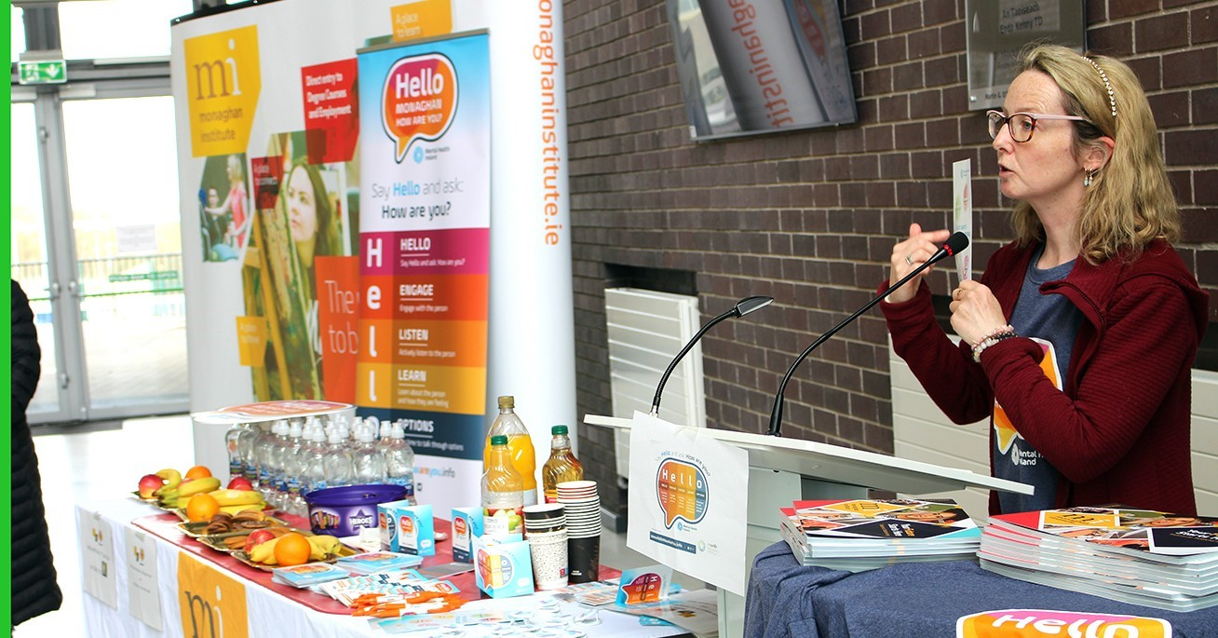
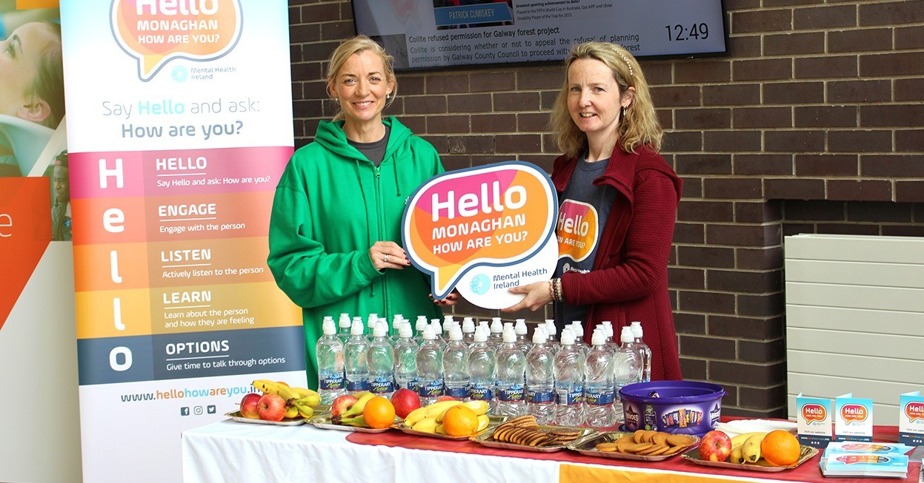

Slide 21
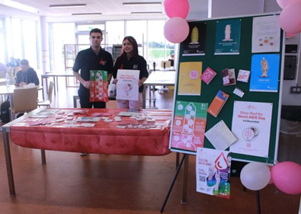
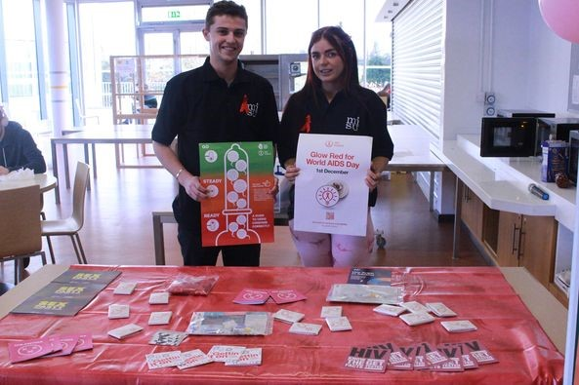
Sexual Health Awareness Stand

Slide 22
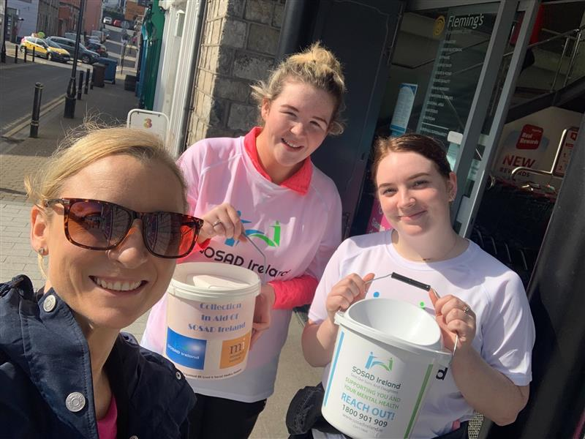
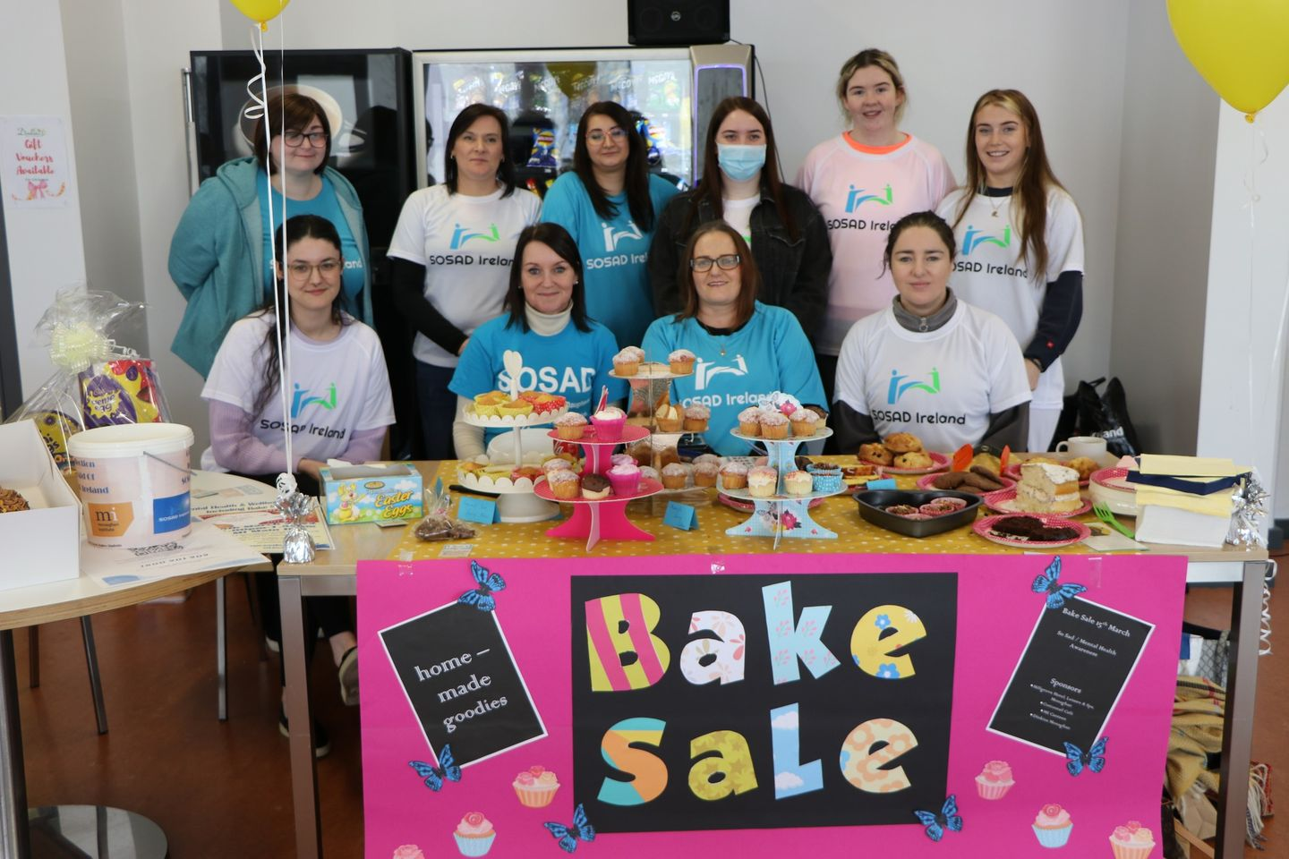
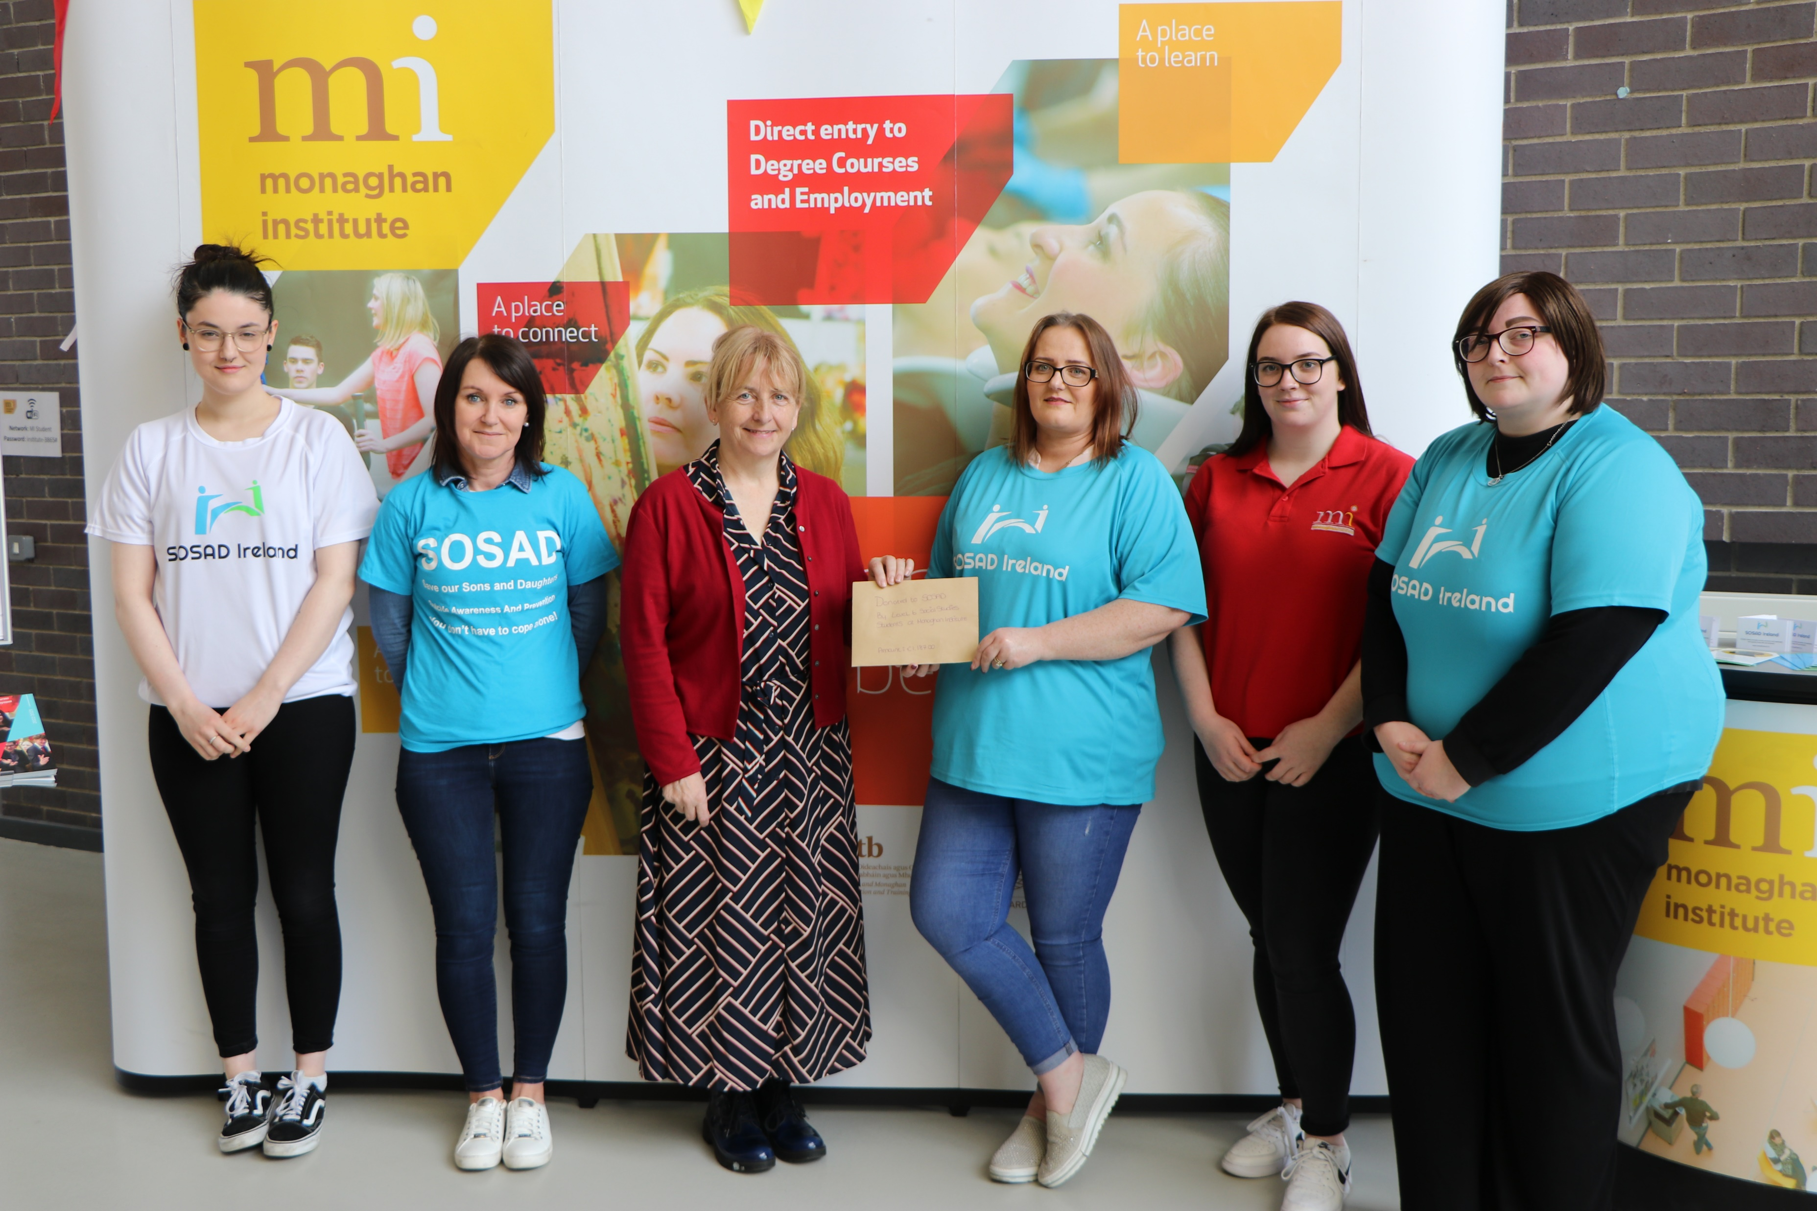
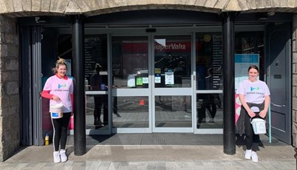
MI Health Promotion Mental Health Awareness Events Fundraising €1200 for SOSAD

Slide 23
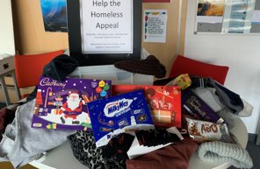
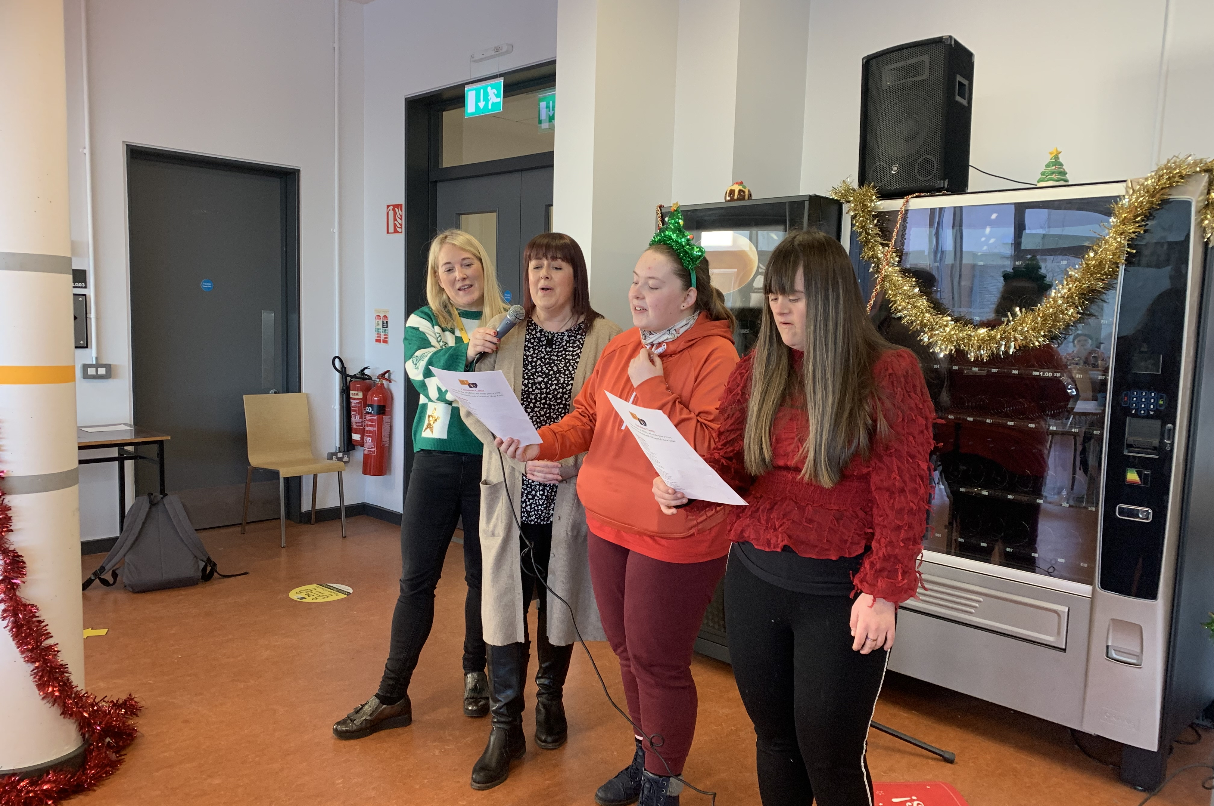
Christmas Carol Singing & Help the Homeless Appeal

Slide 24
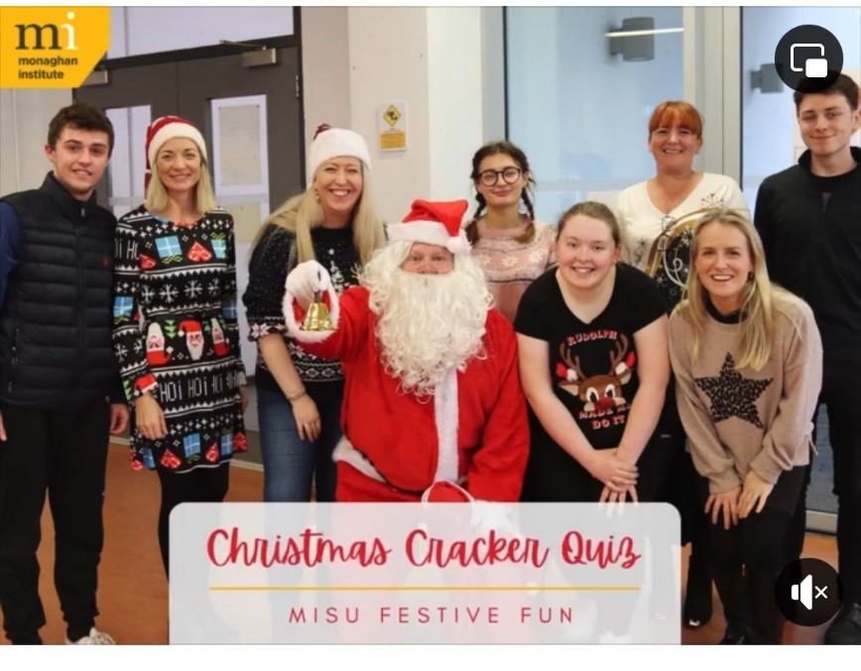
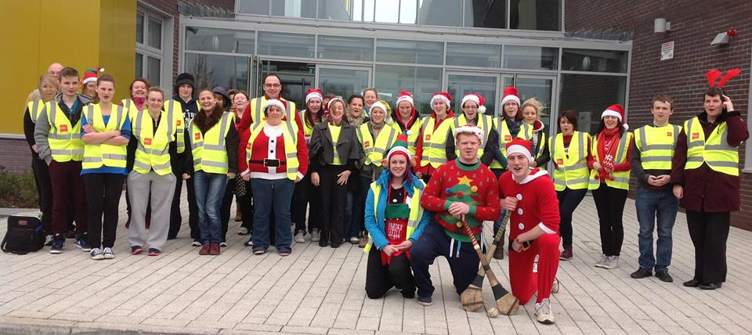
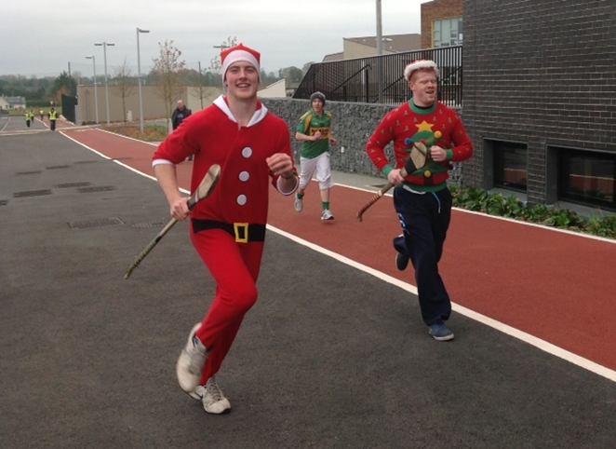
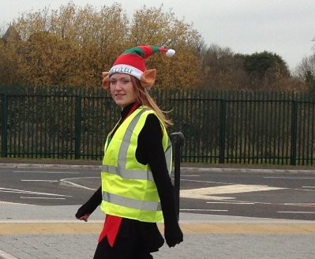
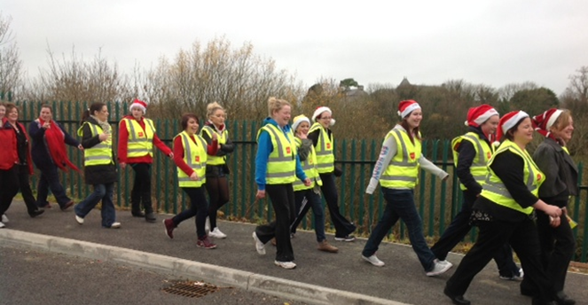
Quizes and Charity Santa Fun Run/Walk

Slide 25
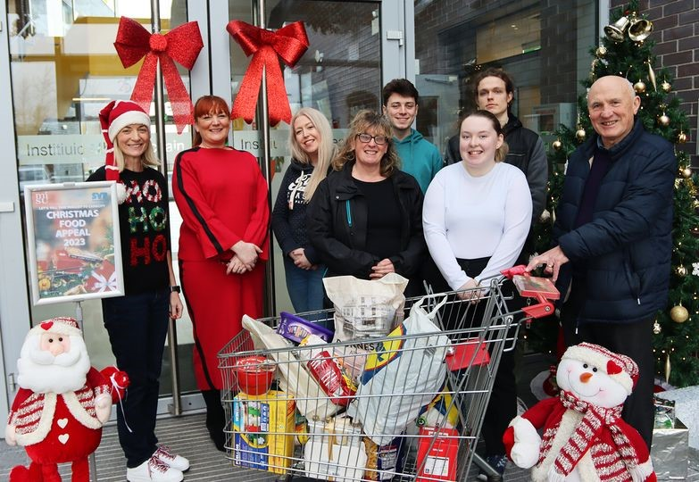
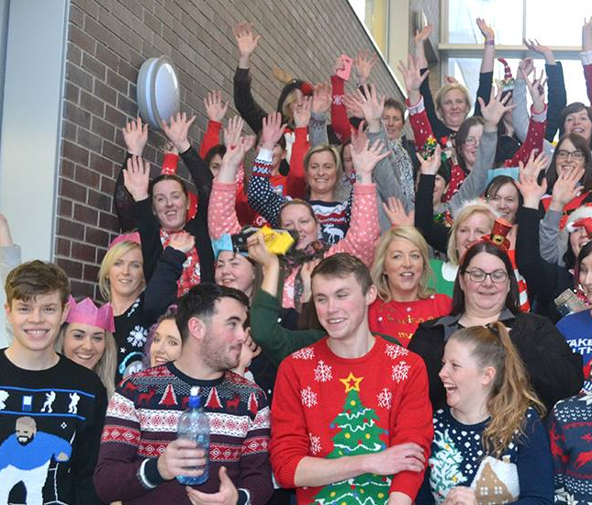
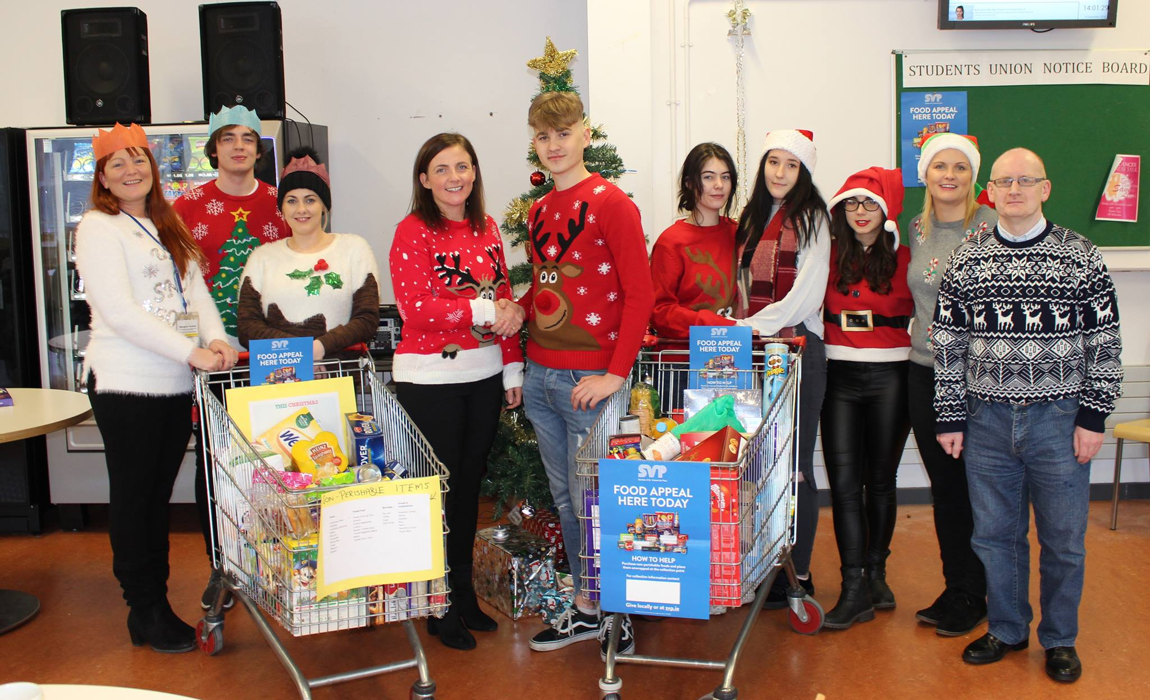
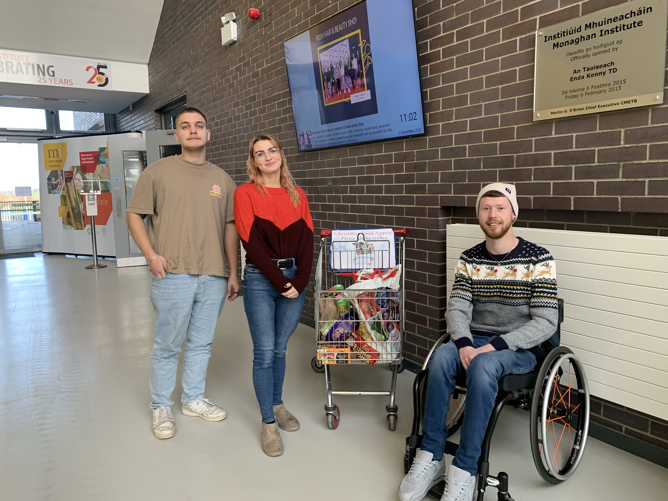
St Vincent De Paul Christmas Food Appeal in the Canteen from 1^{st-} 16th December
Non-perishable items
Tinned food
Pasta
Beans
Packet soup
Jars of sauce etc.

Slide 26
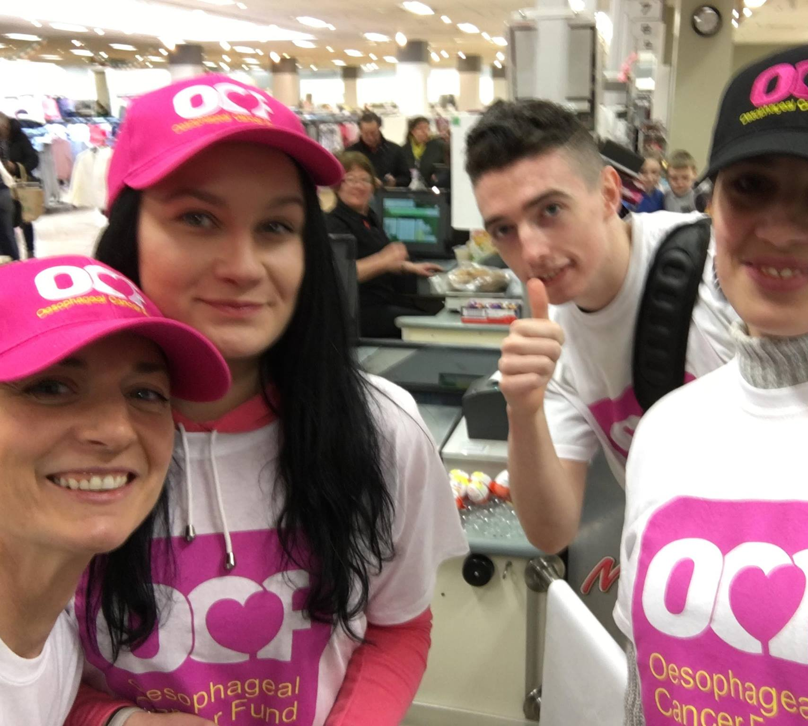


Lollipop Day – Bag Pack

Slide 27



MISU Members fundraised for FOCUS Ireland raised €670

Slide 28


MISU members Helping out at MI Open Days/Evenings

Slide 29




St Patrick's Day Trad Session

Slide 30



Intercultural Awareness and Diversity Day

Slide 31


Lots of Socks Coffee morning Fundraiser for Down Syndrome North East Centre

Slide 32



GREEN DAY – Environmental/Sustainability issues

Slide 33







MI Clubs and Societies are set up by Students
and are self-managed by Students
Setting up a club go to the MI Website SU Page and complete the form

Slide 34




Music club

Slide 35



MI Men’s GAA team

Slide 36

Ladies GAA team

Slide 37


Basketball Club

Slide 38



Table tennis club and Tournaments

Slide 39


Badminton club
Golf Society

Slide 40


Futsal Tournaments

Slide 41





Photography Club Book and Creative Writing Club

Slide 42

We need your creativity to think outside the box! Any Suggestions? Any Questions?

